Slide 1
SQL BASICS
Presented by: Esther OYENEKAN

Slide 2
Objectives
What is Database?
Types Of DBMS
Types RDBMS
Creating Database using MySQL
Writing basic SQL query

Slide 3
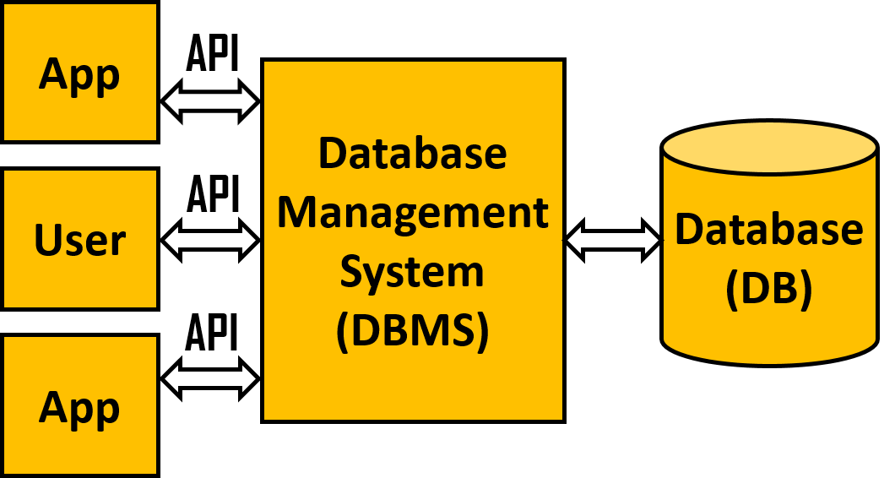
What is database?
A database is a collection of data stored in a format that can be easily accessed.
To manage our database we use software called DataBase Management System, we connect to the DBMS querying the data which gives us result(information).

Slide 4
Types of dbms
There are two types of DBMS. They are;
Relational Database
Non-relational Database
Relational database stores data in form of table. We get data in this database using Structured Query Language (SQL), we use it in modifying and querying our data.

Slide 5
Types of rdbms
MySQL
MS SQL Server
Oracle etc
MySQL is the most popular and open source DBMS in the world.

Slide 6
Creating Database using mysql
The database holds all the table, we will be creating a database to use.
Using the syntax:
CREATE database (database_name)
Note: SQL is not case sensitive. For example CREATE database, create database, CreATe database will give us same result.

Slide 7
Basic SQL QUERY
SELECT statement: It returns a result set of records, from one or more tables.
FROM statement: It specifies the tables to be queried.
WHERE statement: It is use to fetch data according to a criteria or condition.
GROUP BY statement: It groups records that have the same values into a summary record.
ORDER BY statement: It is used to sort the result-set in ascending or descending order. It sort result in ascending by default.

Slide 8
THANk YOU

